Slide 1

Segmentation of RGB-D Data Using RGB-Based Background Subtractors
Two Proposed Methods for Robust Segmentation of Camouflaged Objects
Jacob Fiola

Slide 2
Outline
Intro to segmentation
Problem to solve
Two methods
Quantitative/Qualitative results
Future

Slide 3
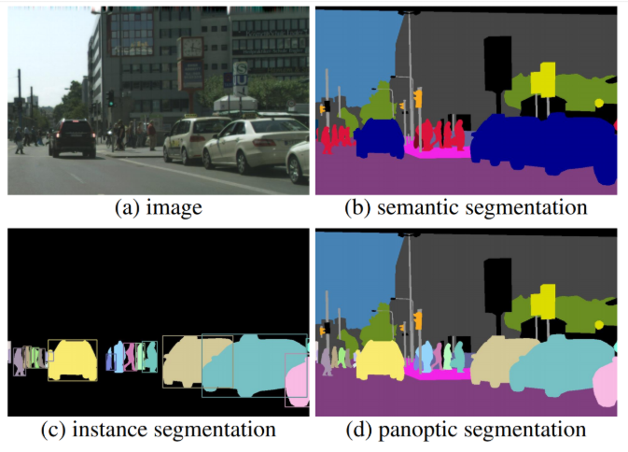
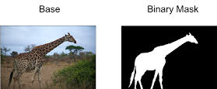
Segmentation: What is it?
Object isolation
Basic, yet critical
Wide variety of uses
Binary mask segmentation (low-level)
Examples of higher-level segmentation algorithms

Slide 4
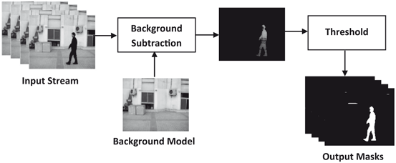
Background subtraction: What is it?
An example of a background subtraction segmentation process using difference thresholding

Slide 5
Prior Background Subtraction Techniques
1) Adaptive Gaussian Mixture Models (MOG1)
2) Improved GMMs (MOG2)
3) Local SVD Binary Pattern (LSBP)
4) Google Summer of Code (GSOC)

Slide 6
Motivation
Figure out location of objects
Segment objects on any complex surface
Accuracy is key

Slide 7
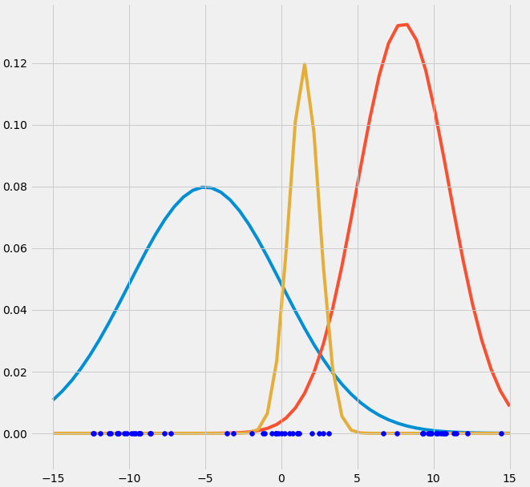

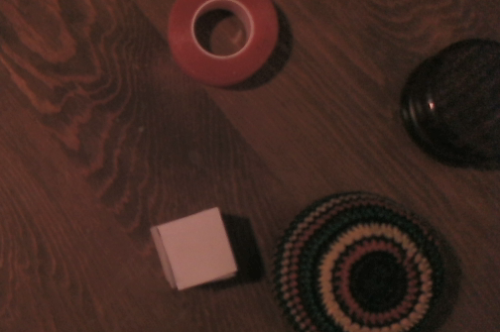
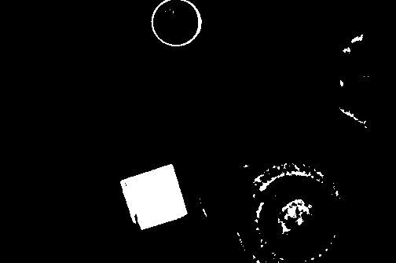
Literature Review: Adaptive Gaussian Mixture Models (MOG1)
Background model
Models each pixel using K Gaussians
Fitness ordering
First B Gaussians = background estimation
If current color stddev > 2.5, mark pixel as foreground
Well rounded
But…
RGB frame
MOG1 segmentation

Slide 8
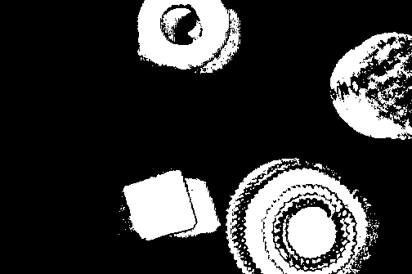
Literature Review: Improved GMMs (MOG2)
Just like MOG1, but now calculates B on a per-pixel basis
A simple tweak, but dramatically better
One of the best
Also well rounded
But…
MOG2 segmentation

Slide 9
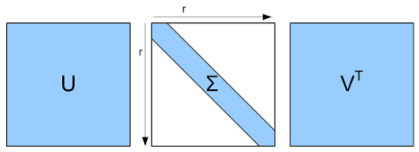
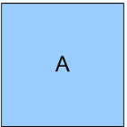
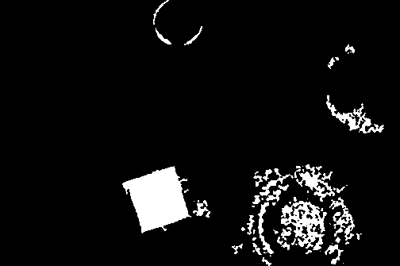
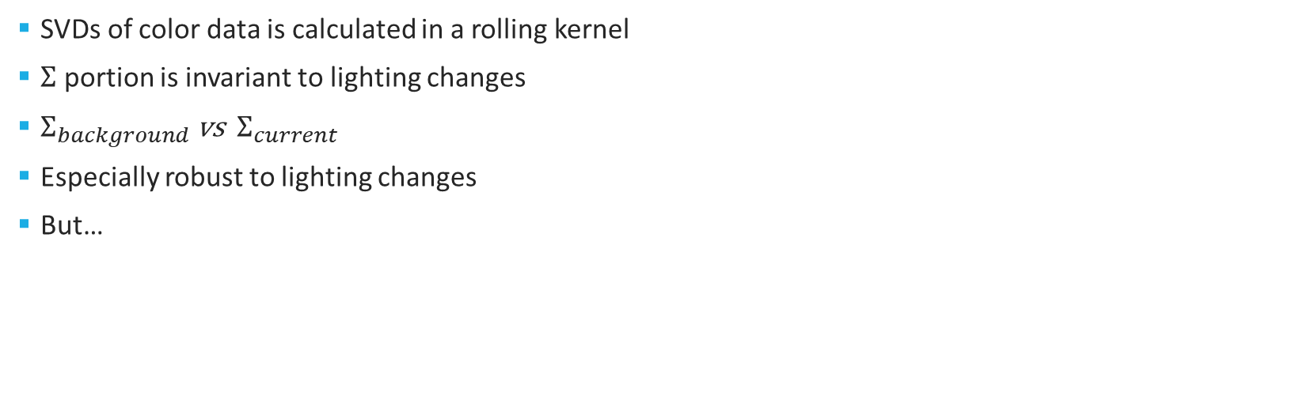
Literature Review: Local SVD Binary Pattern (LSBP)
Current RGB frame
SVDs of color data is calculated in a rolling kernel
$Σ$ portion is invariant to lighting changes
$Σ_{background}$ vs ${ Σ}_{current}$
Especially robust to lighting changes
But…
LSBP segmentation

Slide 10

Literature Review: Google Summer of Code (GSoC)
Also uses LSBP eigenvalues
Per-pixel basis instead of a per-neighborhood basis
Also robust to illumination changes and shadows
But…
GSOC segmentation

Slide 11
The Problem
MOG1 segmentation
MOG2 segmentation
Base RGB image
LSBP segmentation
GSOC segmentation

Slide 12
Solution Overview
Method 1: RGB-based Background Subtraction Using Depth Colormap Input (RBSUDCI)
Method 2: RGB Union + Simple Depth Subtraction (RUSDS) (Supervised and Unsupervised)
Scored using IOU

Slide 13
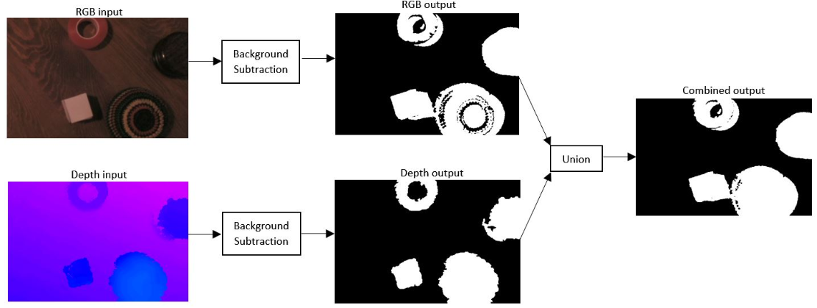
Method 1: RGB-based Background Subtraction Using Depth Colormap Input (RBSUDCI)
Consider depth-based background subtractions
Can utilize any existing RGB-based background subtraction algorithm
An example of the RBSUDCI technique using the GSoC background subtraction algorithm

Slide 14
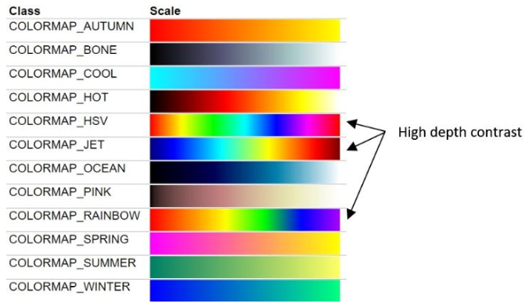
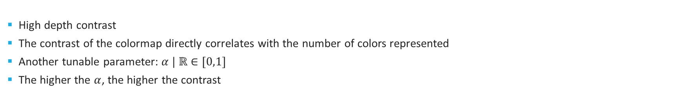
RBSUDCI: Choosing an appropriate depth colormap
High depth contrast
The contrast of the colormap directly correlates with the number of colors represented
Another tunable parameter: $α | ℝ∈[0,1]$
The higher the $α$, the higher the contrast

Slide 15
Method 2: RGB Union + Simple Depth Subtraction (RUSDS)
Calibration
Simple Depth Subtraction
RGB-Union Subtraction
Morphology
Combination
Both supervised and unsupervised adaptations

Slide 16



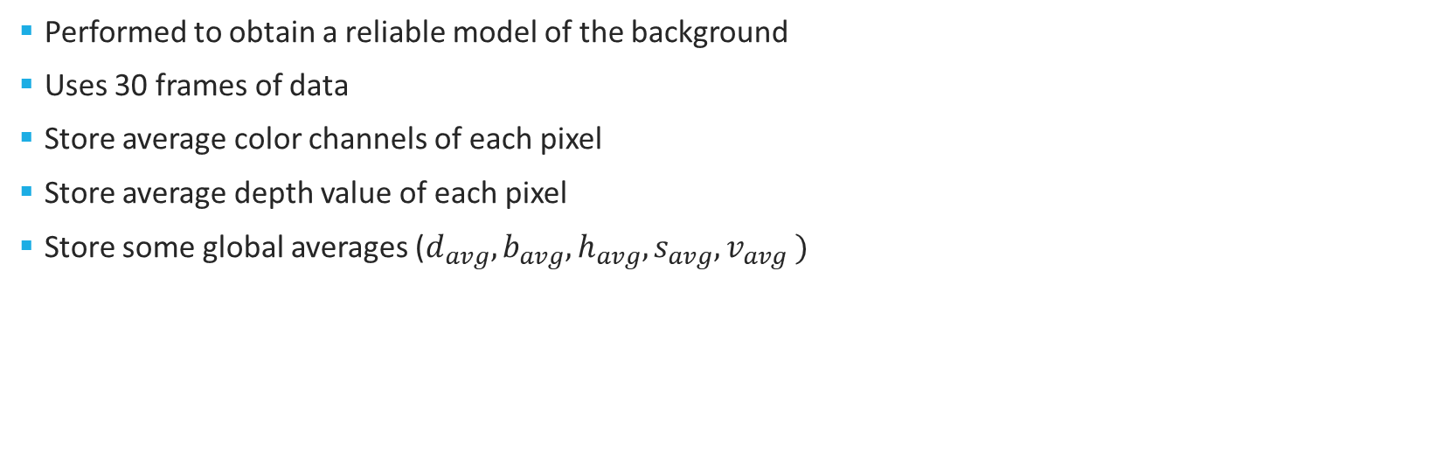



RUSDS - Calibration
Performed to obtain a reliable model of the background
Uses 30 frames of data
Store average color channels of each pixel
Store average depth value of each pixel
Store some global averages ($d_{avg}, b_{avg}, h_{avg}, s_{avg}, v_{avg} )$
Background Model
$$R_{avg}$$
$$G_{avg}$$
$$B_{avg}$$
$$C_{initial}$$
Average Depth value
$$D_{initial}$$

Slide 17
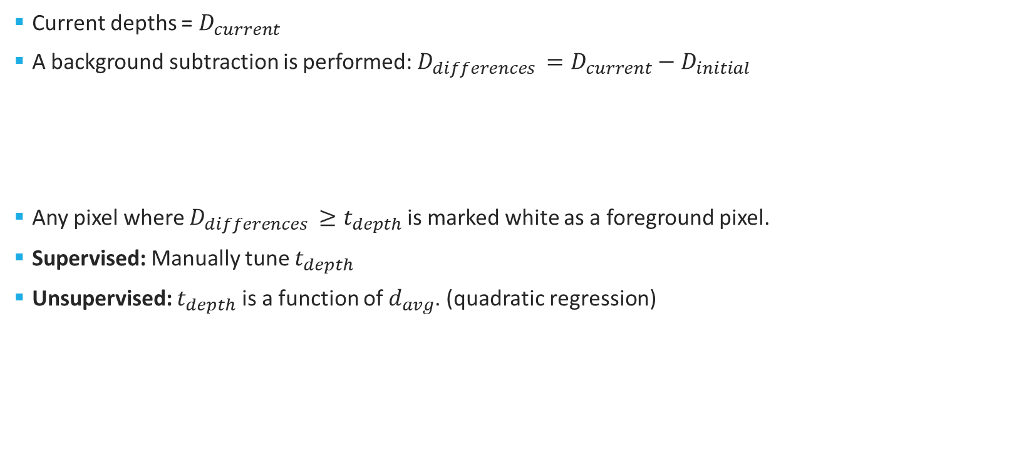



RUSDS - Simple Depth Subtraction
Current depths = $D_{current}$
A background subtraction is performed: $D_{differences }=D_{current}−D_{initial}$
Any pixel where $D_{differences}$ $≥t_{depth}$ is marked white as a foreground pixel.
Supervised: Manually tune $t_{depth}$
Unsupervised: $t_{depth}$ is a function of $d_{avg}$. (quadratic regression)
50
$$D_{current}$$
20
$$D_{initial}$$
30
$$D_{differences}$$

Slide 18




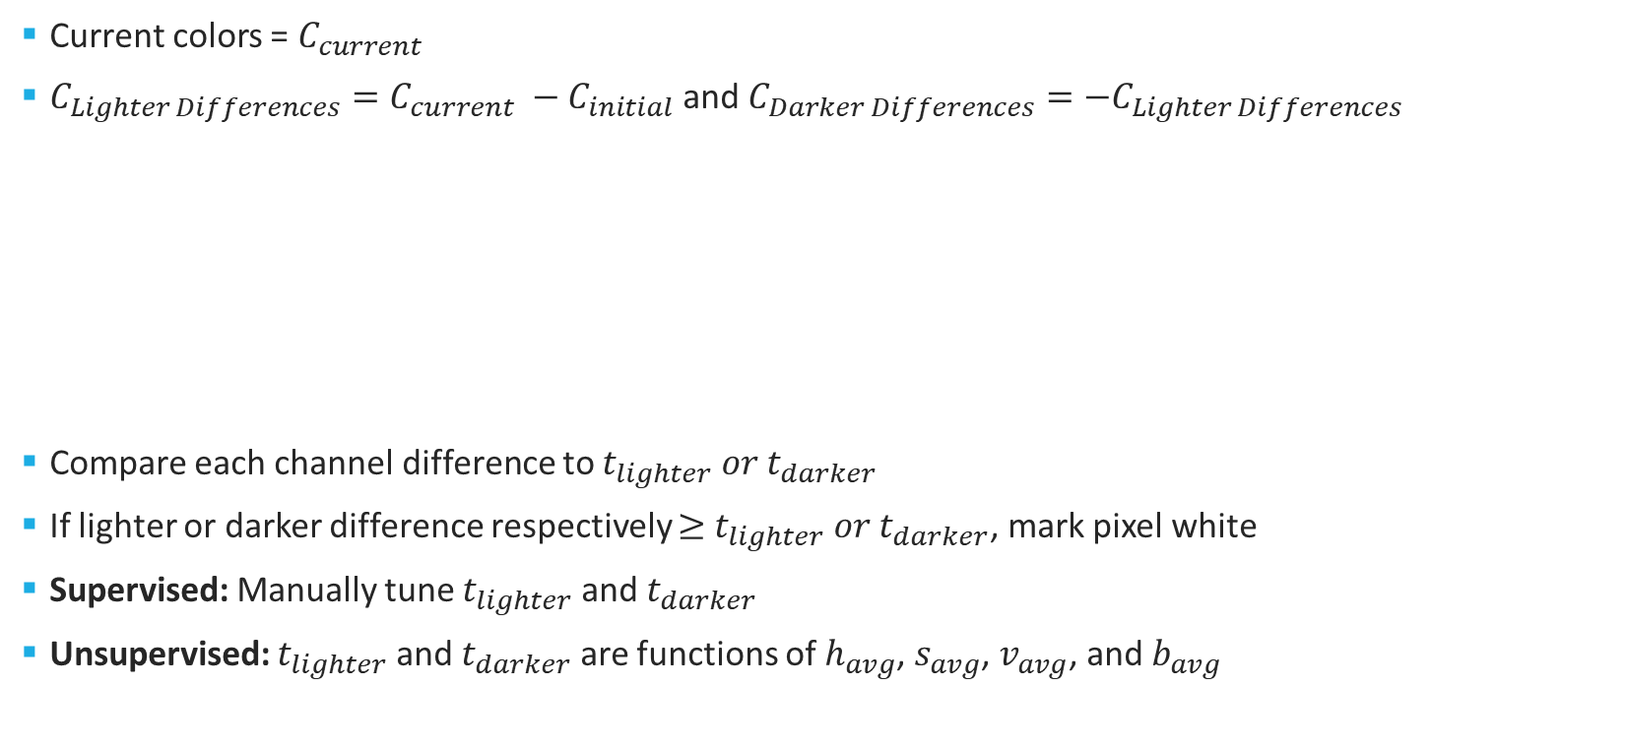







RUSDS – RGB-union subtraction
Current colors =$C_{current}$
$C_{Lighter Differences}=C_{current} −C_{initial}$ and $C_{Darker Differences}={−C}_{Lighter Differences}$
Compare each channel difference to $t_{lighter} or t_{darker}$
If lighter or darker difference respectively $≥$ $t_{lighter} or t_{darker}$, mark pixel white
Supervised: Manually tune $t_{lighter}$ and $t_{darker}$
Unsupervised: $t_{lighter}$ and $t_{darker}$ are functions of $h_{avg}$, $s_{avg}$, $v_{avg}$, and $b_{avg}$
$$80$$
$$90$$
$$40$$
$$C_{current}$$
60
$$80$$
$$60$$
$$C_{initial}$$
$$20$$
$$10$$
$$−20$$
$$C_{Lighter Differences}$$

Slide 19


RUSDS - Morphology
Morphological opening and closing
(2,2) kernel
Example of erosion
Example of dilation

Slide 20
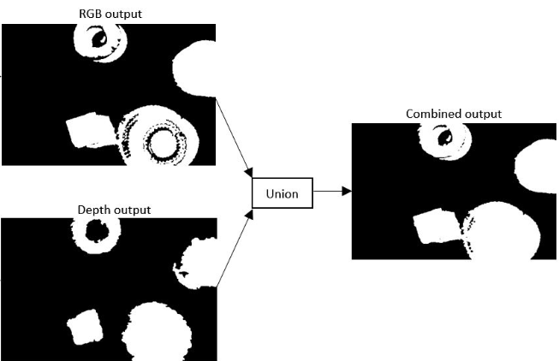
RUSDS - Combination
Combine the two segmentations via union
RBSUDCI performs the exact same combination

Slide 21
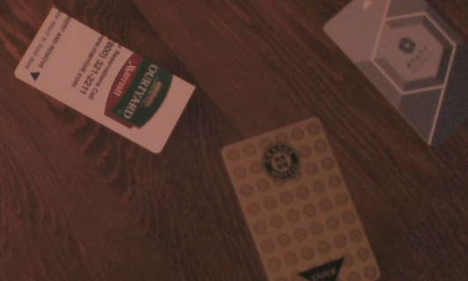
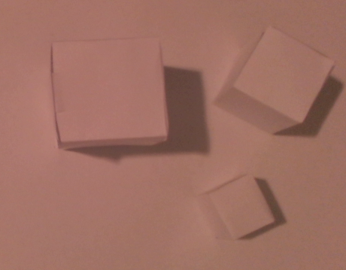
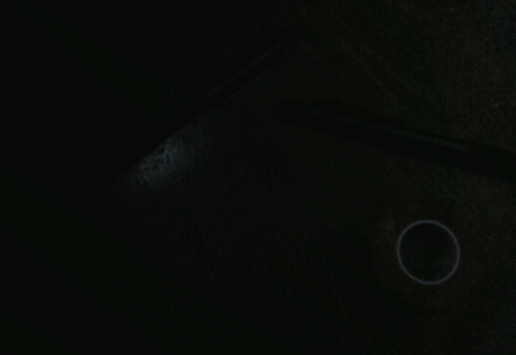
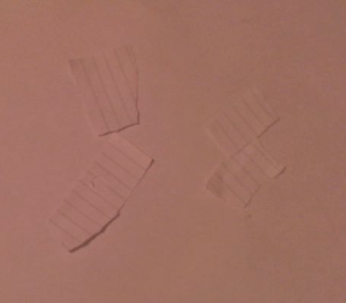
Experiments
Five different environments
Varied in lighting, background surface, and objects of interest
Some high RGB differences, and some high depth differences
Environment 1
Environment 2
Environment 3.1
Environment 3.2
Environment 4

Slide 22
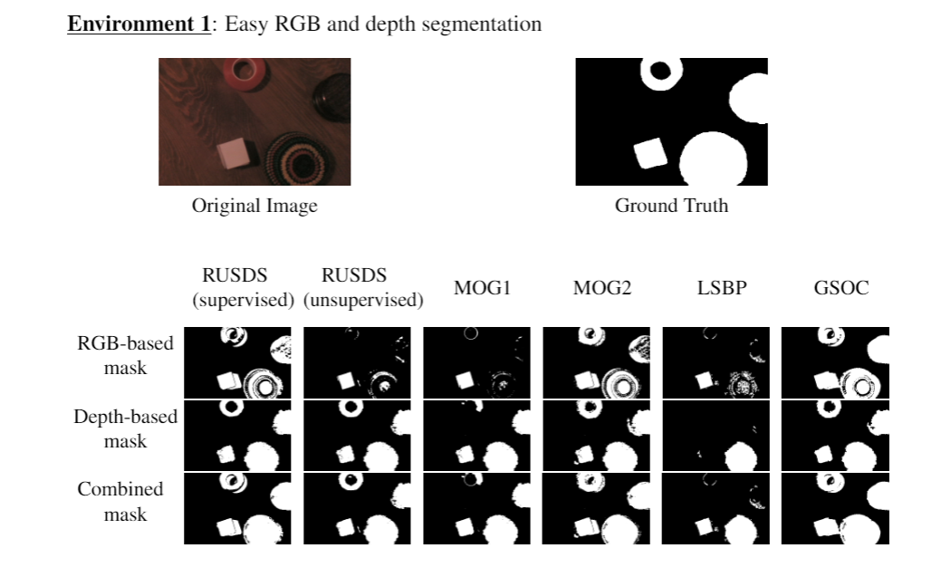
Qualitative Results

Slide 23
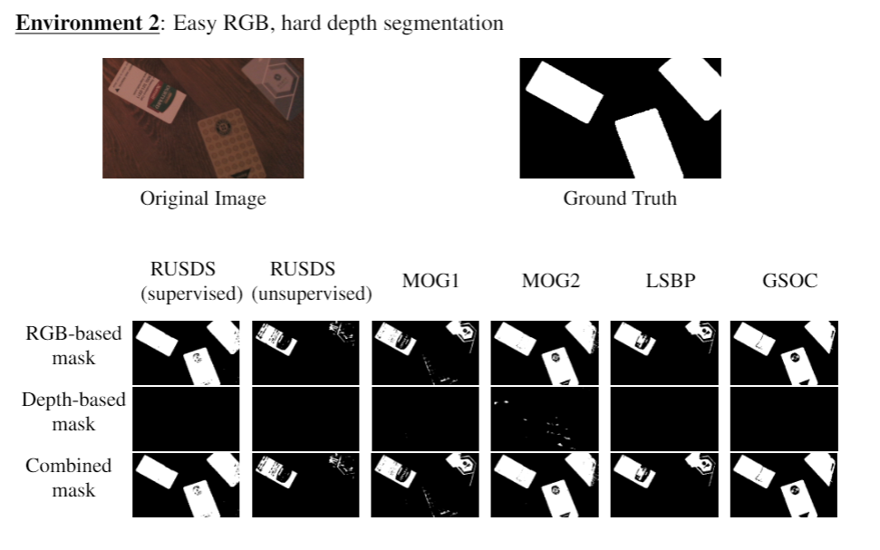
Qualitative Results

Slide 24
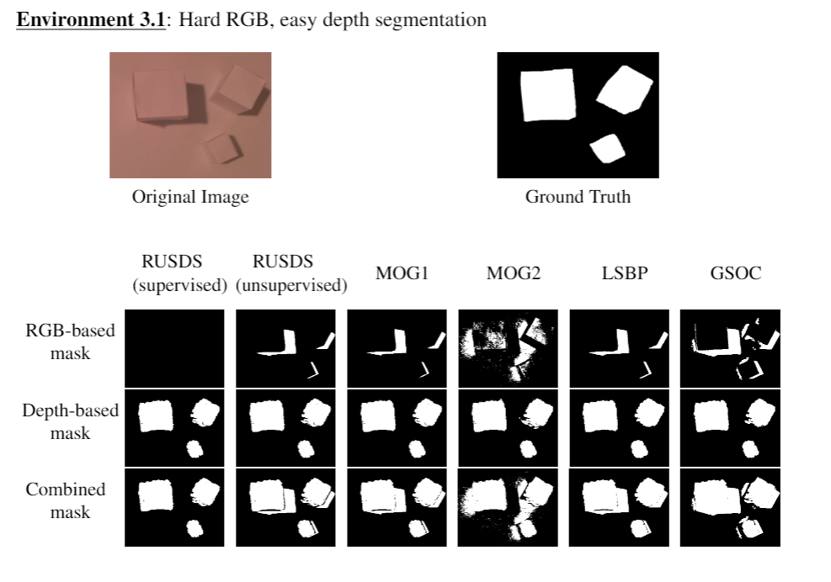
Qualitative Results

Slide 25
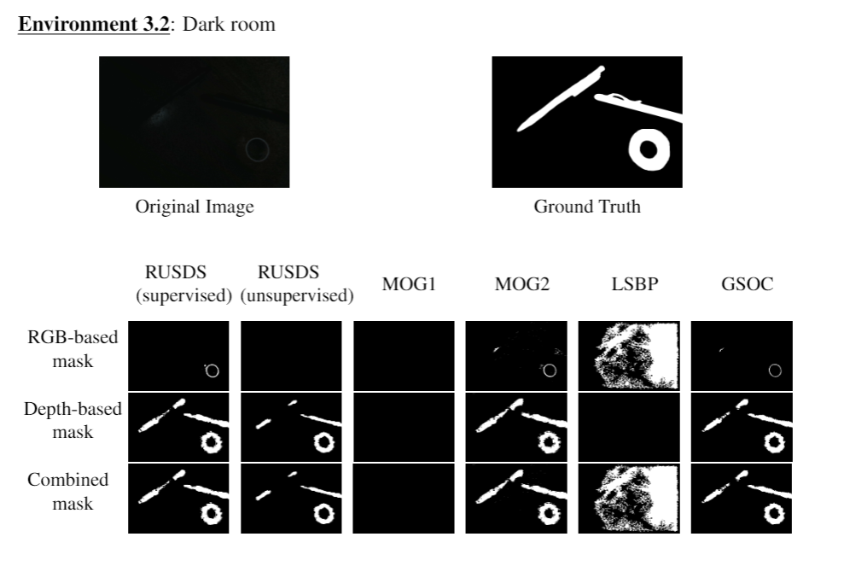
Qualitative Results

Slide 26
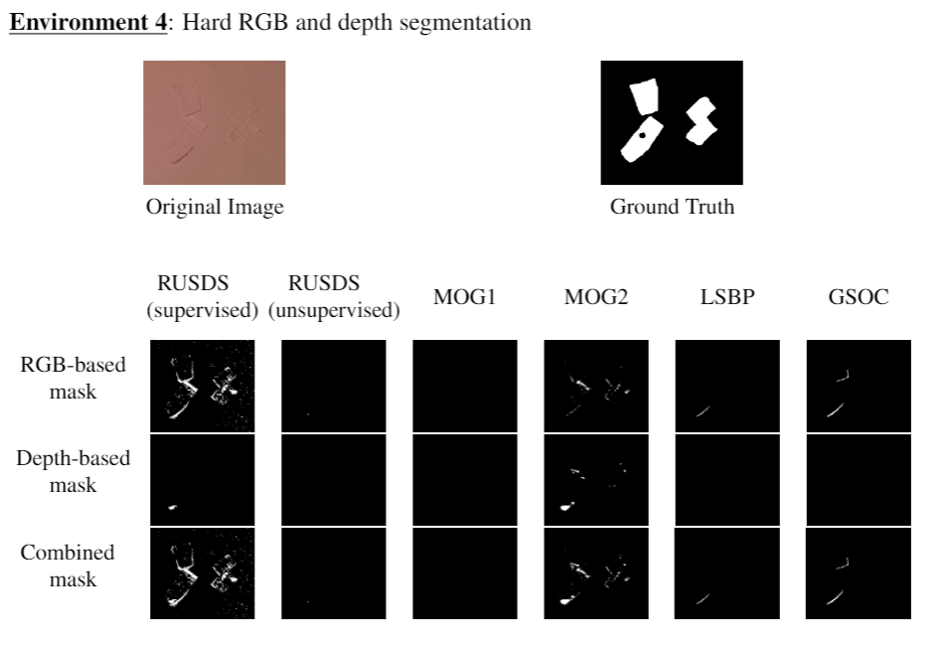
Qualitative Results

Slide 27
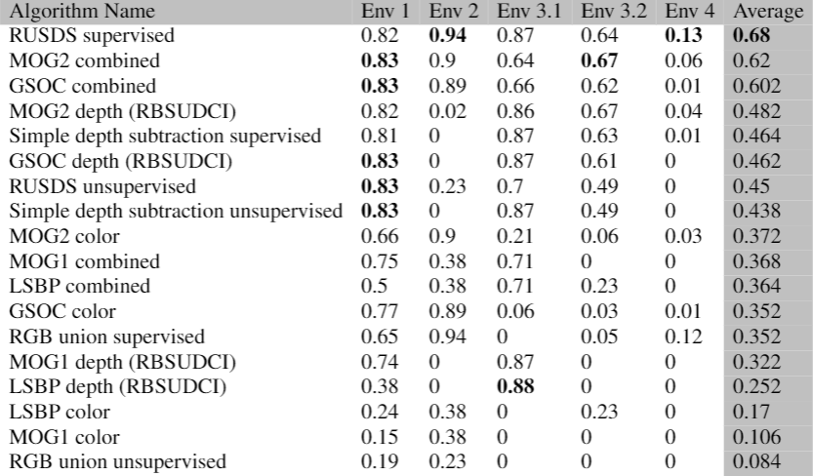
Quantitative Results
IOU scores of segmentation methods used
Most versatile: Supervised RUSDS, MOG2 combined, and GSOC combined.
However: It is recommended that the MOG2 combined method is implemented in most given systems over the RUSDS method.
RUSDS may prove useful within supervised conditions
No combined method performed worse than its RGB-only counterpart.

Slide 28
Conclusion
Two background subtraction methods: RBSUDCI and RUSDS
RBSUDCI segmentations > RGB-only segmentations
RBSUDCI requires less post-processing algorithms to fix problem cases
Unsupervised RUSDS is not reliable enough

Slide 29
Future
High Depth and RGB difference = likely an object of interest
High Depth and low RGB difference = less likely than previous case
Could consider the ratio of RGB vs depth difference on a per-pixel basis.
Large scale, standardized benchmark

Slide 30
Questions?

